Slide 1
General physiology

Slide 2
Unit 1

Slide 3
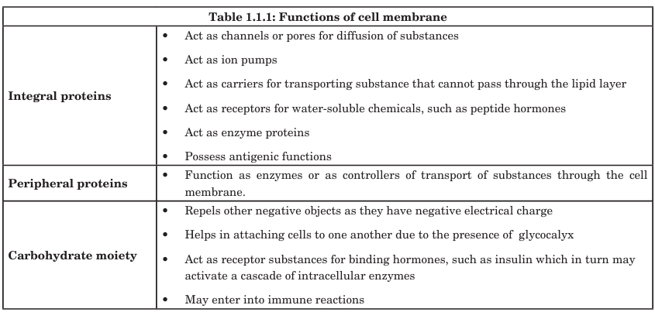

Slide 4
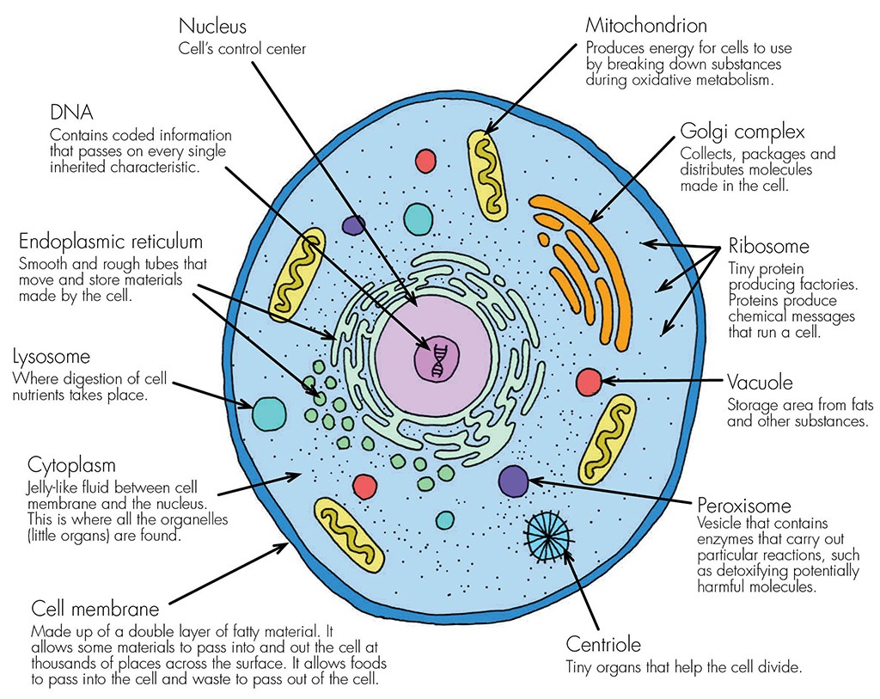

Slide 5
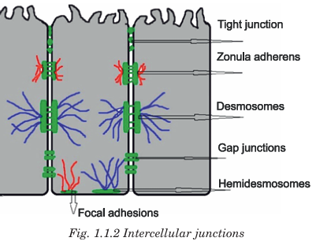

Slide 6
Unit 2

Slide 7
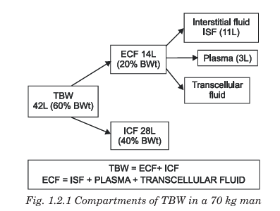

Slide 8
Body fluid regulation
Mechanism | Effect
Thirst centre (Hypothalamus) | Water intake
ADH | Water reabsorption in kidneys
Aldosterone | Na⁺ & water retention
ANP | Water + Na⁺ excretion
Renal regulation | Long-term fluid balance

Slide 9
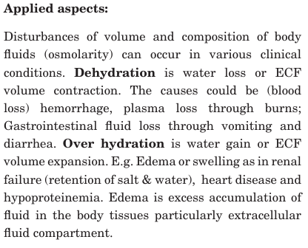

Slide 10
Unit 3

Slide 11
Homeostasis — Definition
Homeostasis is the process by which the body maintains a stable internal environment constant despite changes in the external environment.
It ensures optimum conditions for survival and normal functioning of cells.
Type | Description | Example
Negative feedback | Response reverses the change | Thermoregulation, BP, glucose
Positive feedback | Response enhances the change | Labour contraction (oxytocin), Blood clotting, Lactation

Slide 12
Importance of Homeostasis
Maintains cellular function
Ensures enzyme activity
Stabilizes fluid & electrolyte balance
Maintains internal equilibrium
Essential for survival

Slide 13
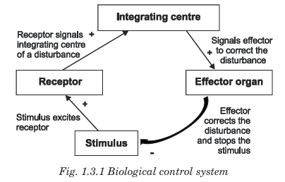

Slide 14
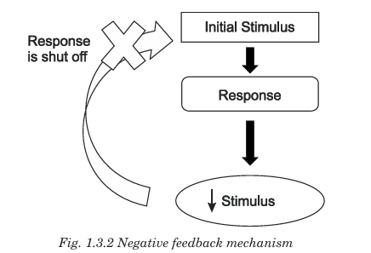
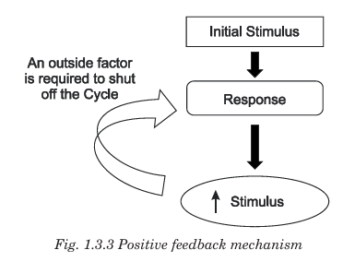
Feedback mechanism

Slide 15
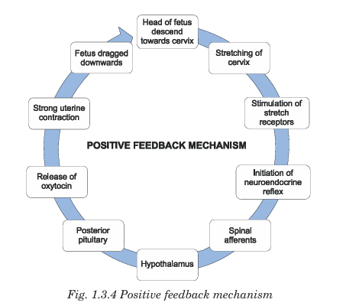

Slide 16
Unit 4

Slide 17
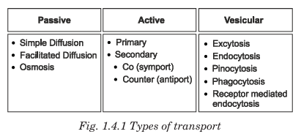
Transport system

Slide 18
Passive transport
Passive transport is the movement of substances across the cell membrane without the expenditure of energy (ATP).
Movement occurs from higher concentration to lower concentration — along the concentration gradient.
Characteristics of Passive Transport
No energy (ATP) required
Down the concentration gradient
Uses membrane proteins in some cases (e.g., channels, carriers)
Occurs until equilibrium is reached
Fast for small, non-polar molecules (O₂, CO₂, lipid-soluble substances)

Slide 19
Type | Description | Example
Simple diffusion | Direct movement through lipid bilayer | O₂, CO₂, fatty acids
Facilitated diffusion | Through channel or carrier proteins | Glucose (via GLUT), ions
Osmosis | Diffusion of water through semipermeable membrane | Absorption of water in intestines
Filtration | Movement due to hydrostatic pressure | Filtration in glomerulus of kidney
Bulk flow (in capillaries) | Large amount of fluid moves along pressure gradient | Capillary exchange

Slide 20
Active transport
Active transport is the movement of substances across the cell membrane from lower concentration to higher concentration (against the concentration gradient) using metabolic energy in the form of ATP.
Key Features
Requires energy (ATP)
Opposes the natural gradient — low → high concentration
Requires specific carrier proteins / pumps
Selective and saturable
Allows cells to maintain ionic imbalance

Slide 21
Type | Description | Example
Primary active transport | ATP directly used to pump solutes | Na⁺/K⁺ pump, Ca²⁺ pump, H⁺ pump
Secondary active transport | Energy from ionic gradient (not direct ATP) drives transport | Na⁺/glucose co-transport, Na⁺/Ca²⁺ exchange

Slide 22
Secondary active transport
Mode | Movement | Example
Co-transport / Symport | Same direction | Na⁺ & glucose into intestinal cells
Counter-transport / Antiport | Opposite direction | Na⁺ in & Ca²⁺ out cardiac muscle

Slide 23
Vesicular transport
Type | Direction | Function
Endocytosis | Into the cell | Uptake of materials
Exocytosis | Out of the cell | Release/secretion of substances
Transcytosis | Across the cell | Movement from one side of cell to other

Slide 24
Endocytosis
Subtype | Description | Example
Phagocytosis (“cell eating”) | Engulfing large particles/microbes | Macrophages ingest bacteria
Pinocytosis (“cell drinking”) | Uptake of fluids & solutes | Intestinal cells
Receptor-mediated endocytosis | Uses receptors for specific uptake | LDL uptake, transferrin, hormones

Slide 25
